Slide 1
Tips for students to online learning

Slide 2
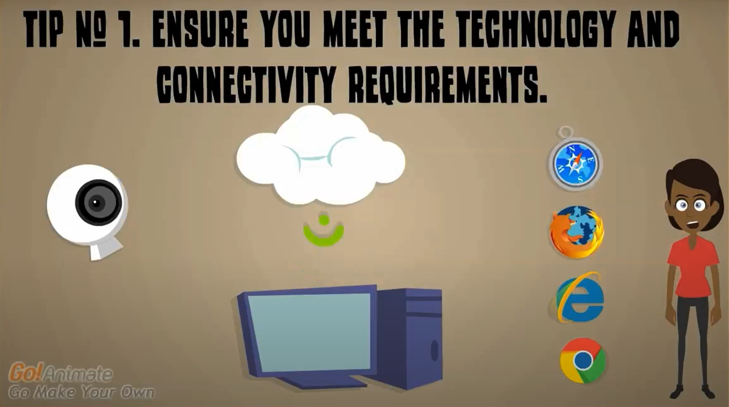
Is your computer and internet speed at home adequate? Do you need to have Google browser installed
in your computer to access Google Classroom?

Slide 3
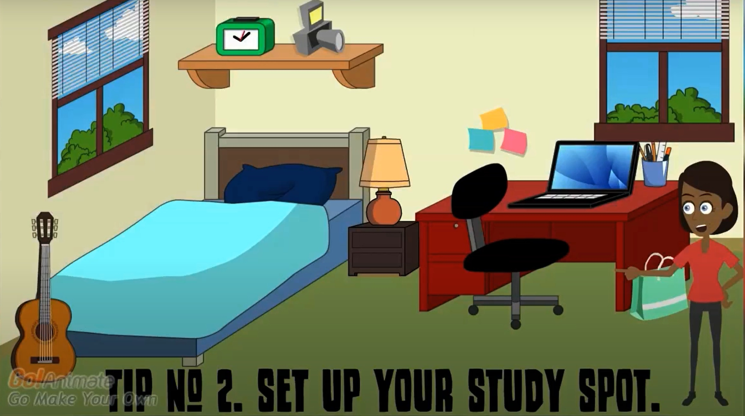
Designate a space at home where you won’t get distracted easily and is comfortable.

Slide 4
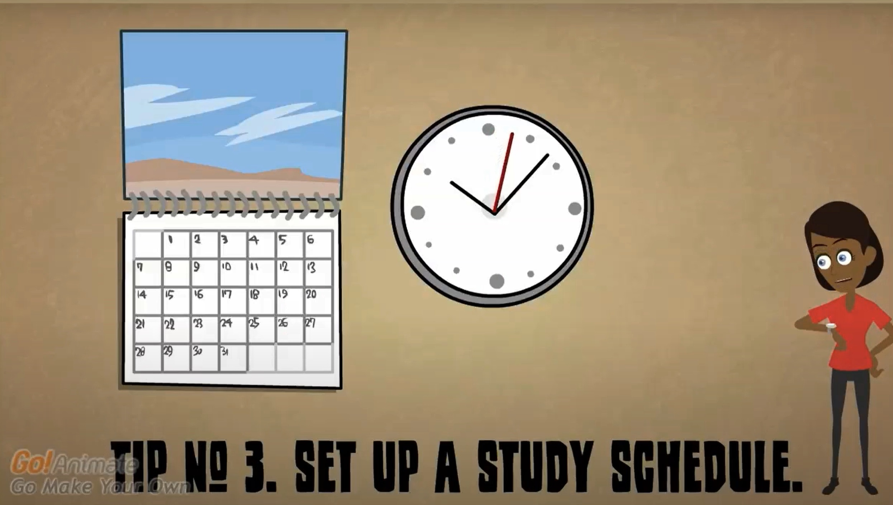
It is easy to put the class to the side since you are not meeting face to face. It’s important you establish a regular
time to give attention to the class.

Slide 5
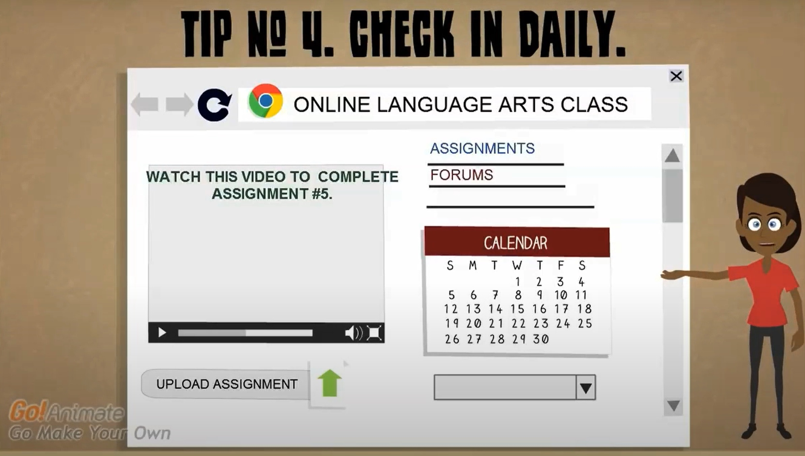
Even though your assignment is not due yet, check in every day to see if your teacher messaged you or posted
an announcement to the class.

Slide 6
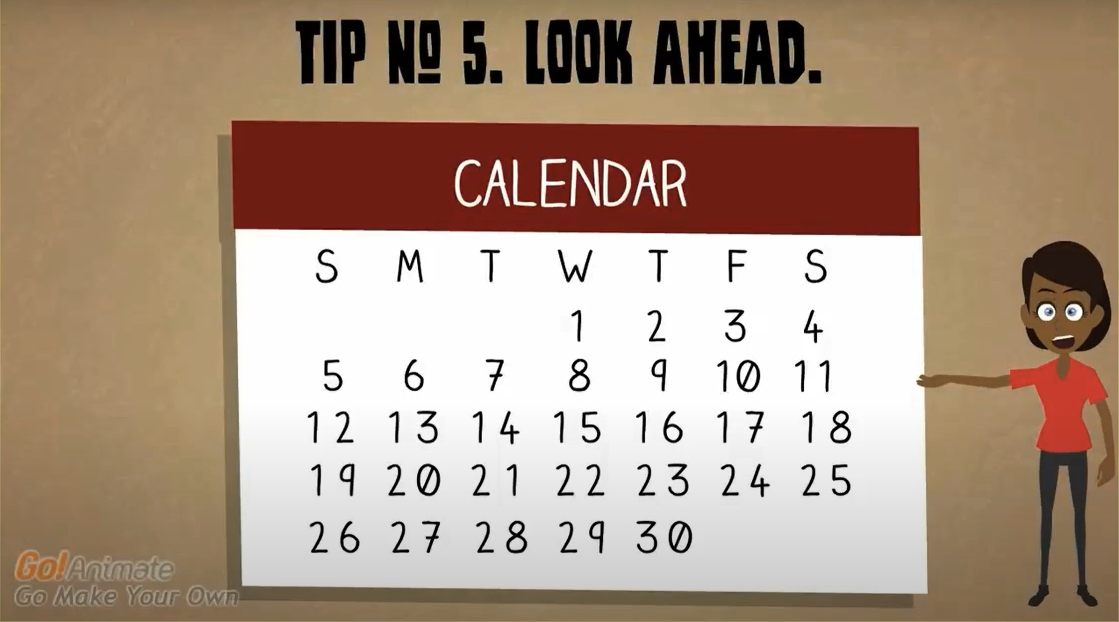
Don’t cram. Know what assignments are due in advance, not just the next day so you can plan you study schedule.

Slide 7
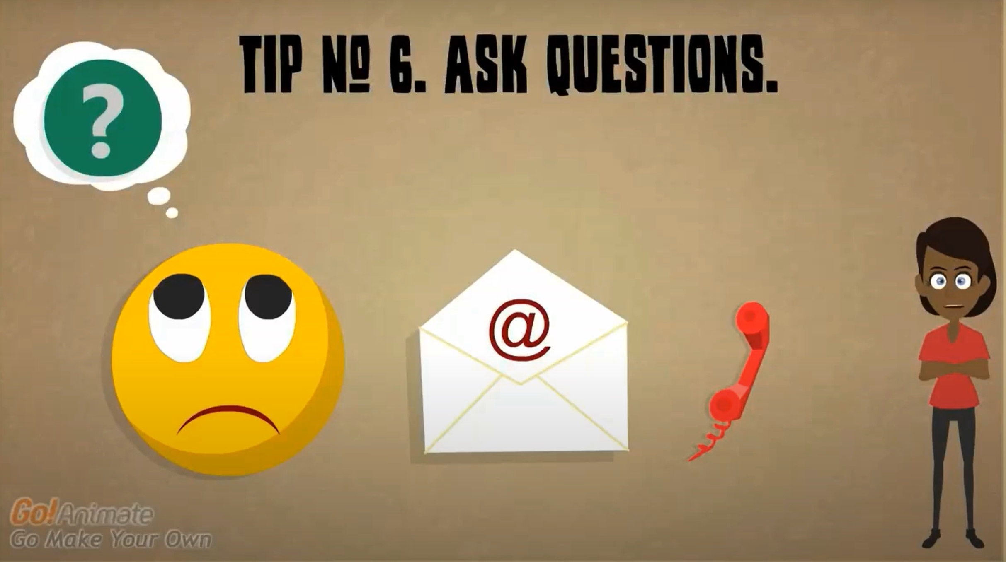
If you have questions about your assignments or need help, message, email or call your teacher.

Slide 8
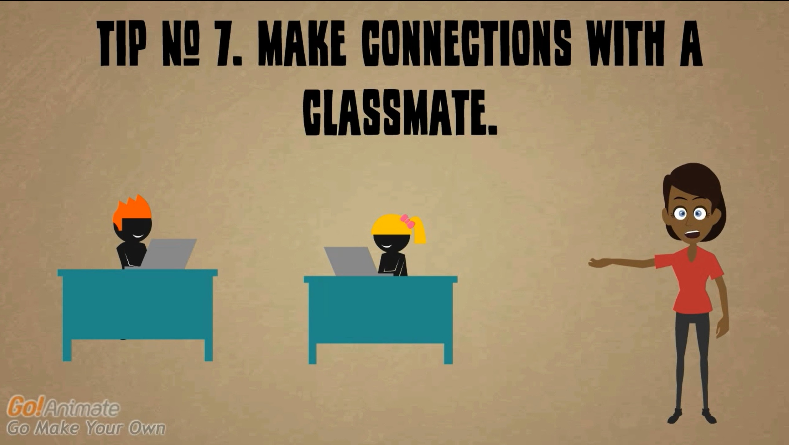
Get to know at least one classmate where you can both motivate each other and help each other out.

